Slide 1
MINISTÉRIO DO PETRÓLEO
E RECURSOS MINERAIS
DEMOCRATIC OF REPUBLIC OF TIMOR-LESTE
CURRENT STATUS OF SEISMIC
PRESENTED BY TIMOR LESTE DELEGATION
EUGENIO SOARES
LUIS TEOFILO DA COSTA
HANOI, September 2015

Slide 2
CONTENTS
1. Introduction
1.1 Timor-Leste
2. Institute of Petroleum and Geology-Public Institute
2.1 Introduction
3. Current Seismic Status in Timor Leste
3.1 Current seismic stations
3.2 Instruments Discription
3.3 Primary Products
3.4 Networks Plan
4. Conclusion

Slide 3
1.INTRODUCTION
MAP OF TIMOR LESTE
1.1 Timor-Leste
República Democrática de Timor-Leste (RDTL)
Administratively was divided into 13 districts,
67 sub-district and 498 villages
Country includes two islands, Atauro and Jaco
Total of area: 15,007 km²
Total of population: until now 1.1 million
Official language: Tetum and Portugues
Climate: summer and winter
East Timor

Slide 4
2. Institute of Petroleum and Geology-Public Institute (IPG)
2.1 Introduction
IPG was established by the Ministry of Petroleum and Mineral Resources (MPRM) under the decree law Nº. 33/2012
Vision: Being an institution of geosciences and research of Geology, Petroleum & Mineral Resources in Timor Leste
Mission:
- Management of geosciences in Petroleum and mineral resources information
- Applied scientific research in the field of Petroleum &Mineral Resources
- Relations with other public agencies and private

Slide 5
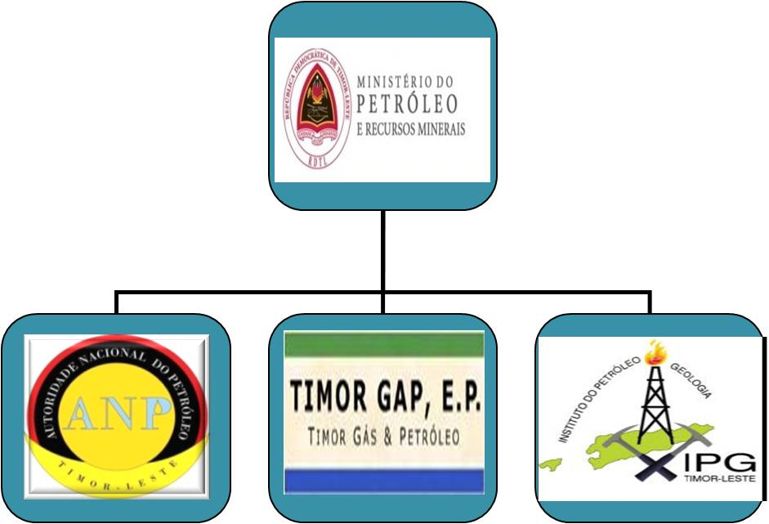
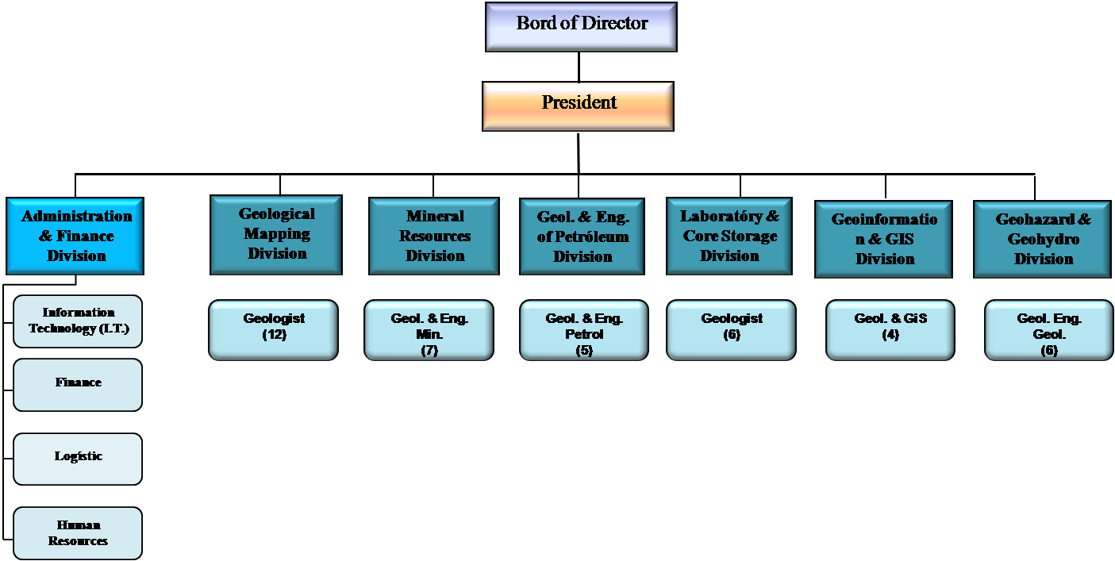
2.2. IPG organization was founded: 2012
Structure of organization:
Part of Government Department

Slide 6
SEISMIC STATIONS
TL01 : 9.2421⁰S 124.3567⁰E
TL02 : 8.9883⁰S 125.2080⁰E
TL03 : 8.6041⁰S 125.5572⁰E
TL04 : 8.2212⁰S 125.6065⁰E
TL05 : 8.9853⁰S 125.6598⁰E
TL06 : 8.4718^{ᴼ} S 126.4575^{ᴼ} E
TL07 : 8.8557^{ᴼ} S 126.3628^{ᴼ} E
TL08 : 8.4947^{ᴼ} S 126.9908^{ᴼ} E

Slide 7
DESCRIPTION OF INSTRUMENTS
Digitizer : Nanometric Taurus
Seismometer : Broadband seismometer (Nanometrics Trillium 120PA)
Seismic network analysis : “PASSCAL”
Energy : Solar Panel

Slide 8
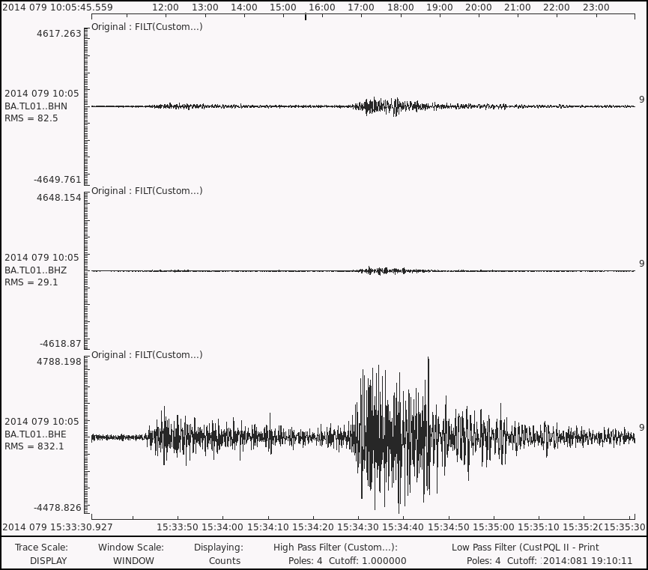
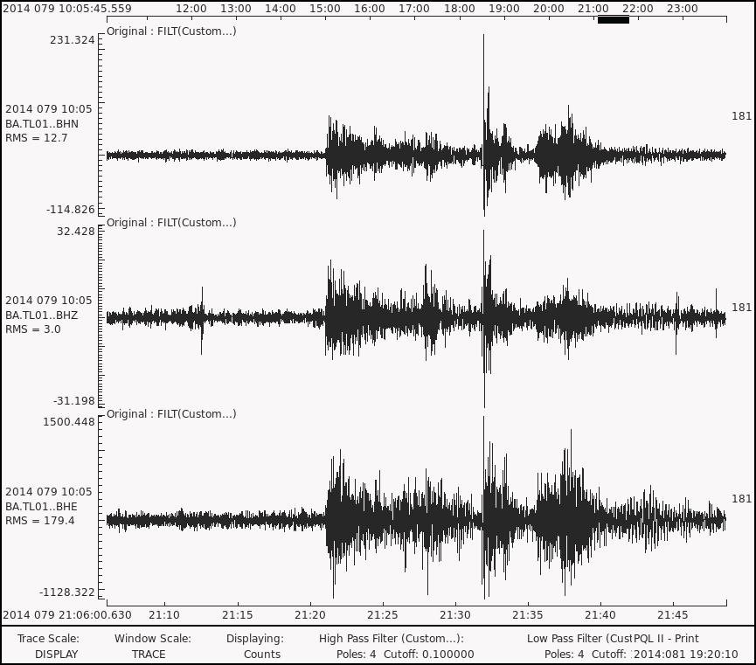
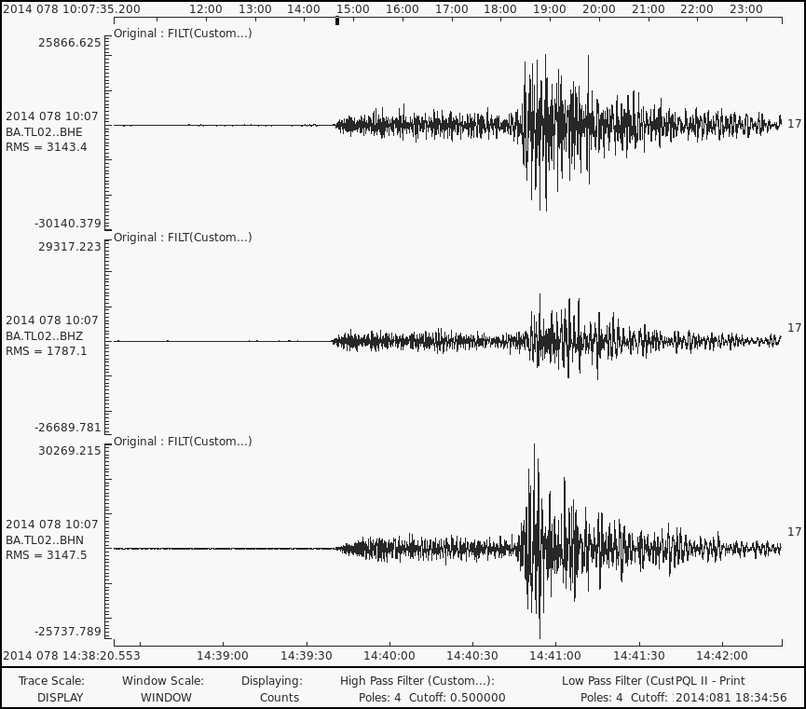
PRIMARY PRODUCT

Slide 9
SEISMIC NETWORK PLAN
Will established 2 – 3 permanent seismometer stations in the next few years.
Will become the Affiliation member of IRIS in November 2015
Seeking for international cooperation and supports.

Slide 11
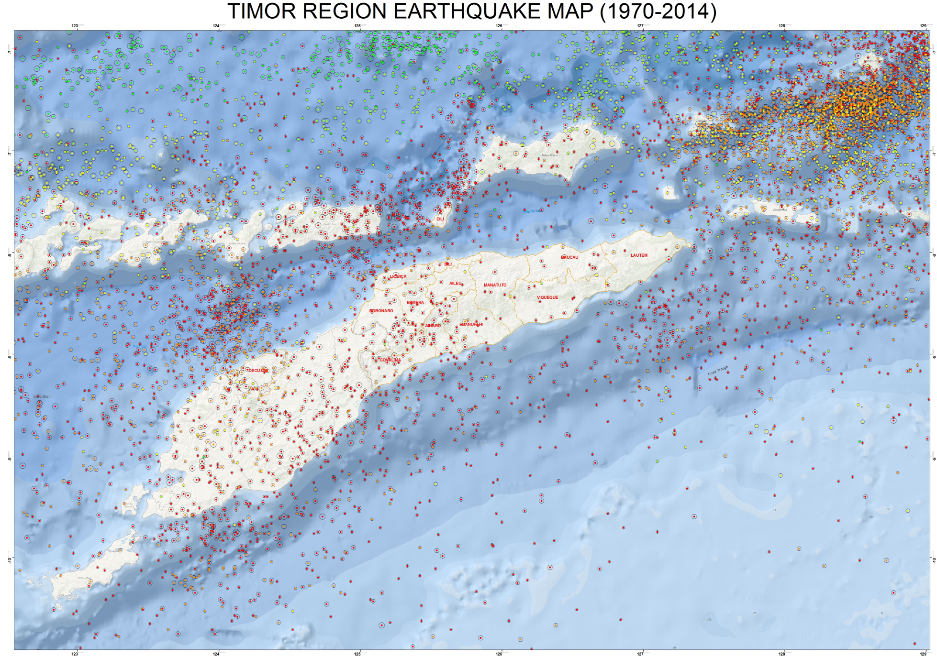
4.Conclusion

Slide 12
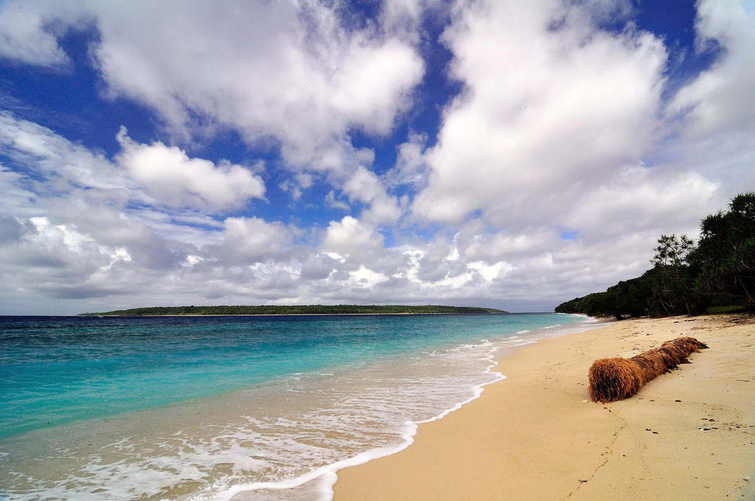
OBRIGADO
THANK YOU

